Slide 1
Valley Isle Aquatics
Adrian Grimm
WDD229

Slide 2
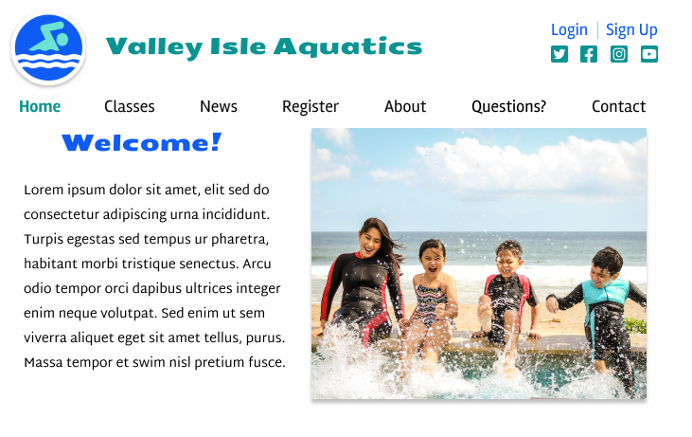

Slide 3
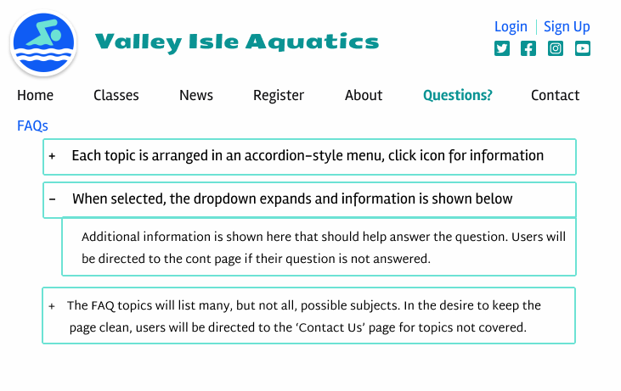

Slide 4
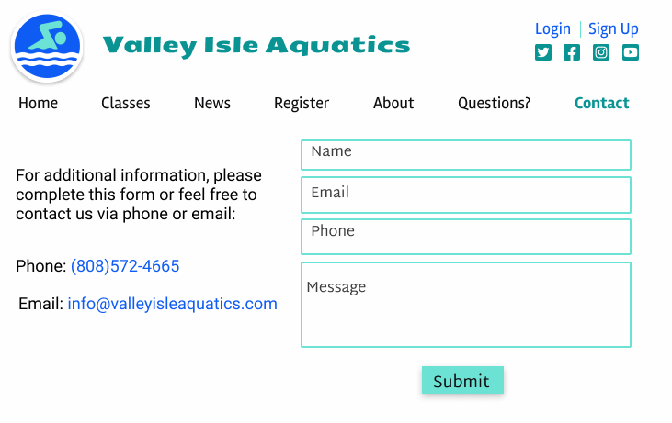

Slide 5
color scheme
The same color Palette is used throughout the site to promote continuity
The white background lends a clean appearance
A mix of blues and greens gives an aquatic feel
The current page is colored green to set itself apart on the nav bar
The paragraph text is black so as not to distract the reader from the importance of the text.
The blue text of the phone and email also serves to identify them as links

Slide 6

color Palette

Slide 7
typography
‘sans Serif’ fonts are used throughout for a modern feel
The logo and ‘Welcome’ text were chosen as displays and a “playful” font was necessary to add appeal to the page
The paragraph font is roboto, a clean, easily read, basic sans serif font
The nav bar uses rambla, another sans serif font that separates itself from the other sections on all pages

